Slide 1
ERAU ASCEND
Arizona Space Grant Symposium 2020

Slide 2
Team
Thomas Fike - Project Lead
Nicodemus Phaklides - Hardware Lead
Xander Picard - Consultant
Dr. Douglas Isenberg - Mentor

Slide 3
Semester Goals
Create a reliable data collection system to be used as a backbone for future experiments
Build a comprehensive temperature model of the payload in high-altitude environments
Develop a more intuitive understanding of PCB design

Slide 4
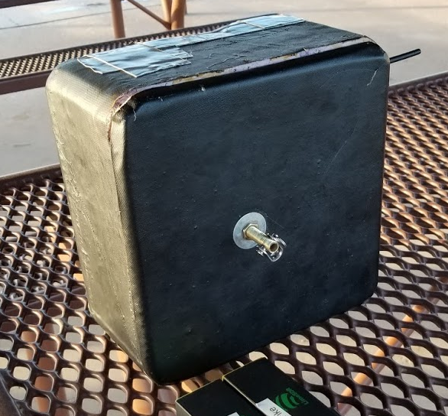
Payload Structure
Insulating foam box
1” thick walls
Payload electronics are mounted via an acrylic plate inside the foam box
Proven safe and reliable, flight tested three times

Slide 5
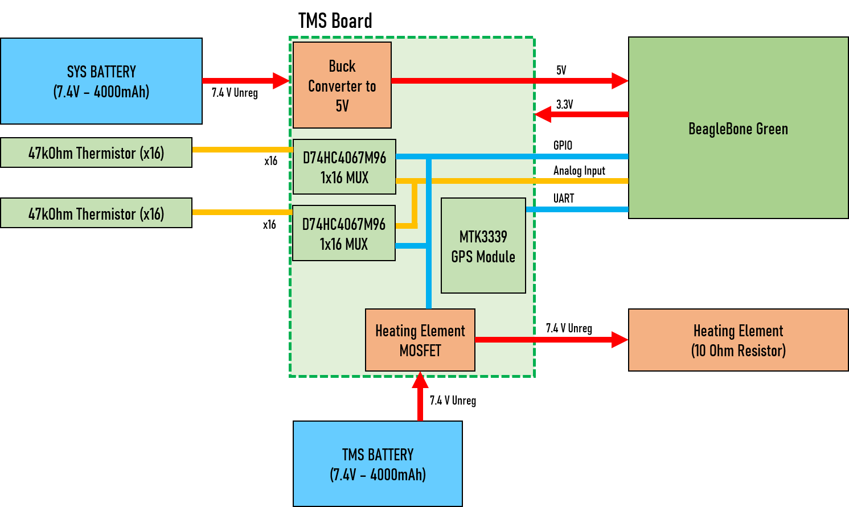
System Block Diagram

Slide 6
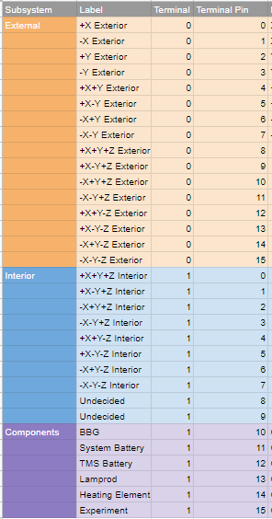
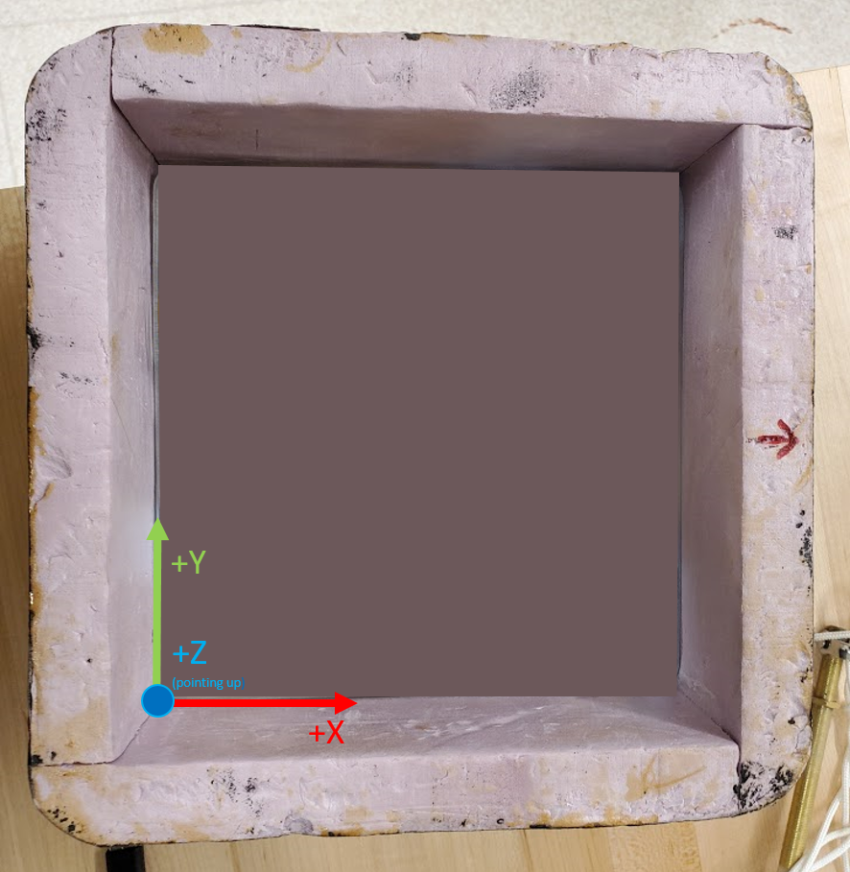
Thermistor Placements

Slide 7
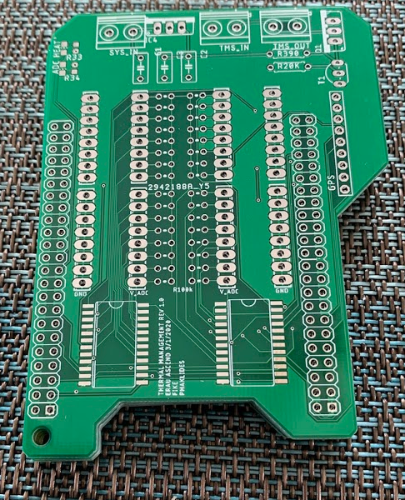
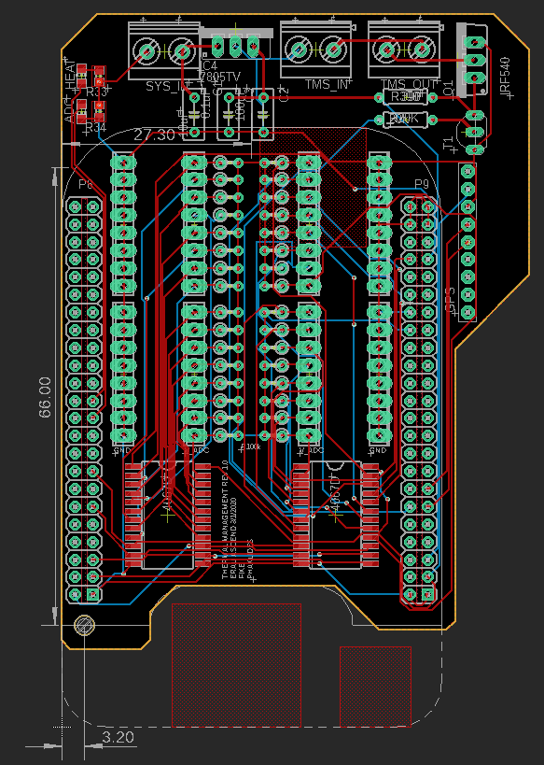
TMS Board Design
Functionality
Regulates battery voltage to 5V
Interfaces thermistors with MUXs
Controls heating element
Interfaces with GPS module
TMS Board was designed in EAGLE 9.5.2
Made to fit on top of and interface with BeageBone Green

Slide 8
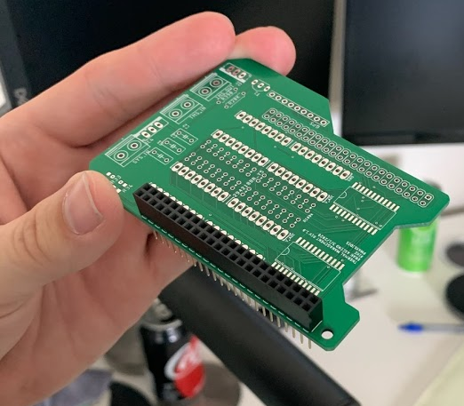
TMS Board Testing
Enough components were purchased to build a testing version of the board as well as a flight model
Testing and board construction halted due to COVID-19 precautions

Slide 9
Software Requirements
Record flight data for the entirely of the flight.
The software shall continue operating even if an inflight reboot occurs.
Record data every 1 second.
Software is written in Python2 using the BBIO library from Adafruit

Slide 10
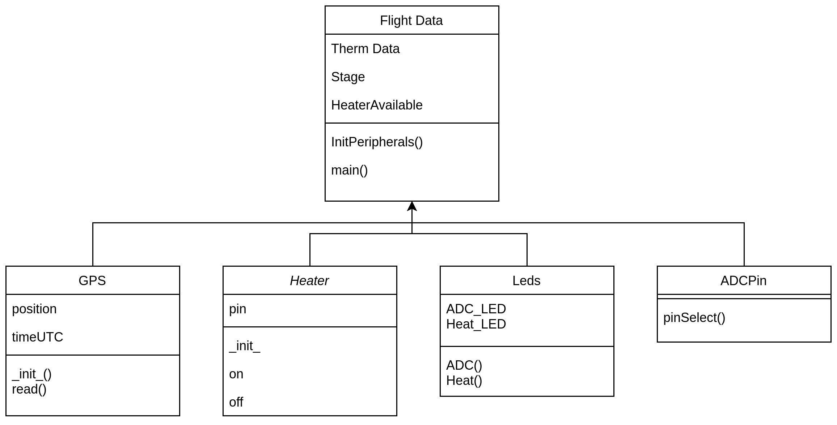
Software Design

Slide 11
Future Work
Continuing from this semester:
Assemble TMS Boards and test
Fly payload and gather temperature data
Use this data to construct a full temperature model
For the flight after:
Research payload stabilization methods
Design a rev 2.0 of the TMS Board to feature new experiments

Slide 12
Questions or Comments?
Contact Thomas Fike or Nicodemus Phaklides
Thomas: fiket1@my.erau.edu
Nicodemus: phaklidn@my.erau.edu

